Slide 1
Understanding HTTP and REST
Oxford University
Software Engineering Programme
April 2021

Slide 2

World Wide Web
navigating document collections
multimedia documents
hypertext cross-references
hypertext markup language
(HTML)
hypertext transfer protocol
(HTTP)
Tim Berners-Lee at CERN, 1989–1992

Slide 3
HTTP
two-way transmission of requests and responses
layered over TCP
essentially stateless (but. . . )
standard extensions for security

Slide 4
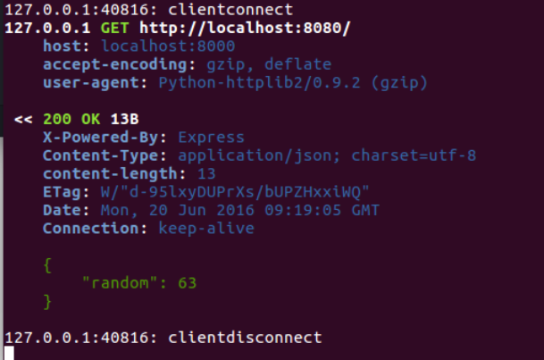

Slide 5
HTTP “Verbs”
GET uri
read a document; should be “safe”
PUT uri, data
create or modify a resource; should be idempotent
POST uri, data
create a subordinate resource
DELETE uri
delete a resource; should be idempotent
(also HEAD, TRACE, OPTIONS, CONNECT and now PATCH)

Slide 6
More VERBS
HEAD - just get the metadata
OPTIONS - which verbs are supported?
PATCH - just send the updates

Slide 7
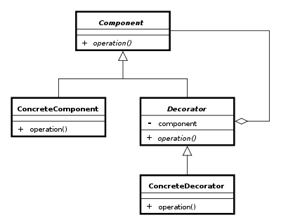
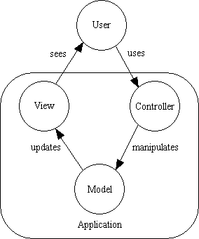
Examples of Design Patterns

Slide 8
REST is a design pattern
Also characterized as an Architectural Style (aka an architecture design pattern)

Slide 9
Doesn’t REST just mean using HTTP?

Slide 10
REST
Roy Fielding, a principal author of HTTP
PhD thesis Architectural Styles and the Design of Network-based
Subsequent article Principled Design of the Modern Web Architecture (ACM TOIT 2:2, 2002)
Richardson & Ruby, RESTful Web Services architectural patterns of the web

Slide 11
Core ideas of REST
“Treat HTTP seriously”
Every “object” has a unique URL
Use the correct “VERB”:
GET, POST, PUT, DELETE
Use content-types properly
Use good HTTP return codes
Use hyperlinks

Slide 12
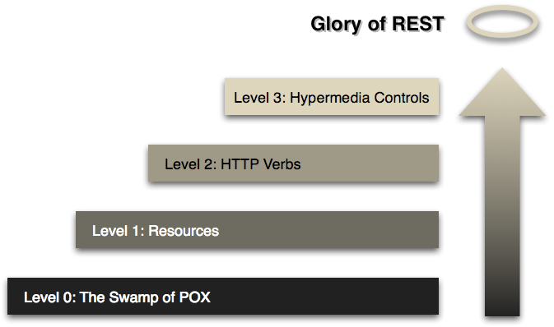
Richardson’s Maturity Model

Slide 13
HTTP good bad and ugly
Good
GET reports/open-bugs HTTP/1.1
in contrast to RPC-style interaction
Bad
POST /rpc HTTP/1.1 Host: www.upcdatabase.com <?xml version="1.0”> <methodCall> <methodName>lookupUPC</methodName> … </methodCall>
Ugly
http://www.flickr.com/services/rest?method=search&tags=cat

Slide 14
Core HTTP Verbs
GET
get a representation of a resource
no side effects or updates to the resource
cacheable & idempotent
PUT
update a resource
idempotent
POST
create a new resource
DELETE
remove a resource
idempotent

Slide 15
URLs for resources
http://mybank.com/account/11002123
→
{
balance: 1100.10,
transactions:
“/account/11002123/transactions”
}

Slide 16
Hyperlinks
http://mybank.com/account/11002123/transactions/1→
{
from: “http://otherbank.com/ac/50893432/”,
to: “/account/11002123”
amount: 34.12,
date: “1/1/2021”
}

Slide 17
PUT vs POST
creation by either PUT to new URI or POST to existing URI
use PUT when client chooses URI;
use POST when server chooses
typically, create a “subordinate” resource with a POST to its parent
successful POST returns code 201 ‘Created’ with Location header

Slide 18
POST example
POST /account/11002123/transactions
{
to: “https://otherbank.com/ac/88819999”,
amount: “23.11”,
date: “1/1/2021”
}
returns
201 Created
Location: /account/11002123/transactions/2

Slide 19
Resource Representations and States
Interact with services using representations of resources.
An XML representation
A JSON representation
An object referenced by one URI can have different formats available.
A mobile application may need JSON
A Java application may need XML.
Utilize the Content-Type header
And the Accept: header
Communicate in a stateless manner
Stateless applications are far more scaleable

Slide 20
Hypertext as the Engine of Application State
Resources are identified by URIs
↓
Clients communicate with resources via requests using a
standard set of methods
↓
Requests and responses contain resource representations
in formats identified by media types
↓
Responses contain URIs that link to further resources
↓
Beginning

Slide 21
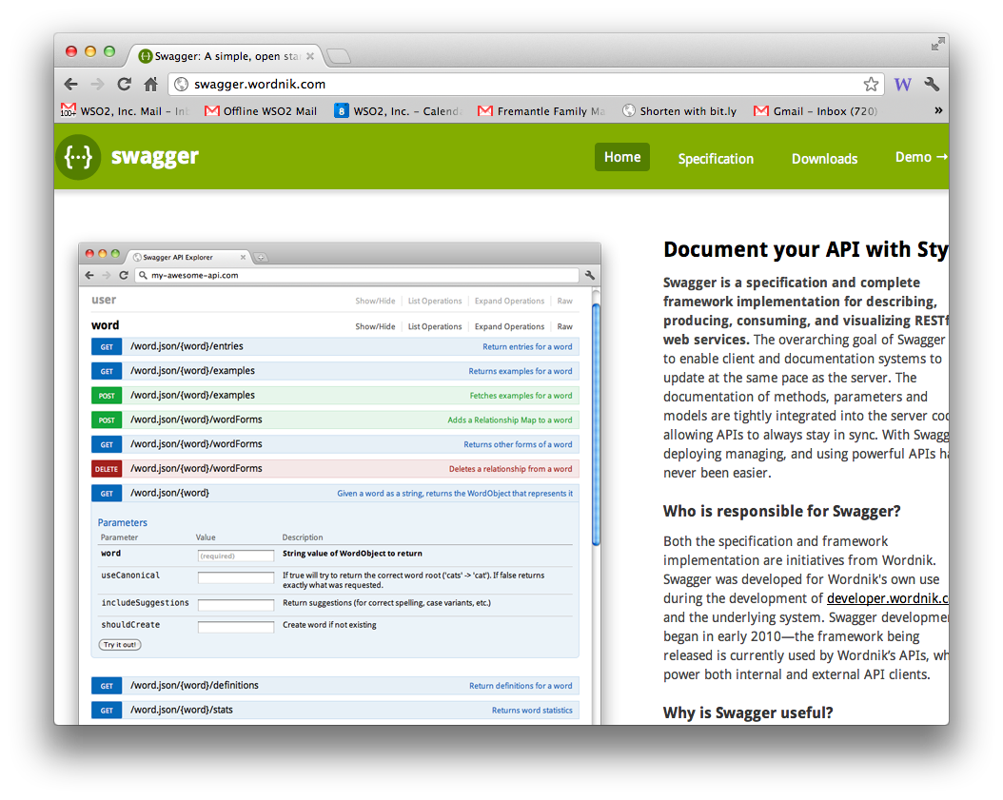
REST description
more later!

Slide 22
Return codes
Good RESTful design means proper use of return codes…
Why?

Slide 23
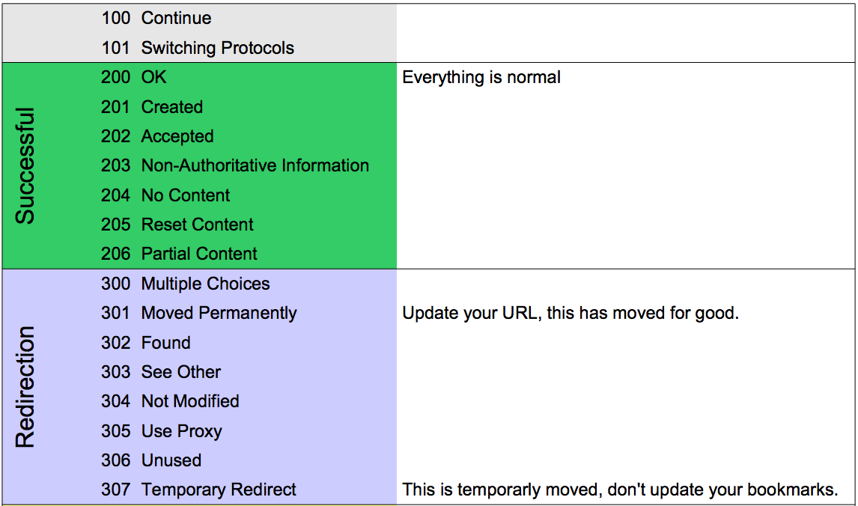
HTTP return codes
http://www.cheat-sheets.org/saved-copy/http-response-codes-1.pdf

Slide 24
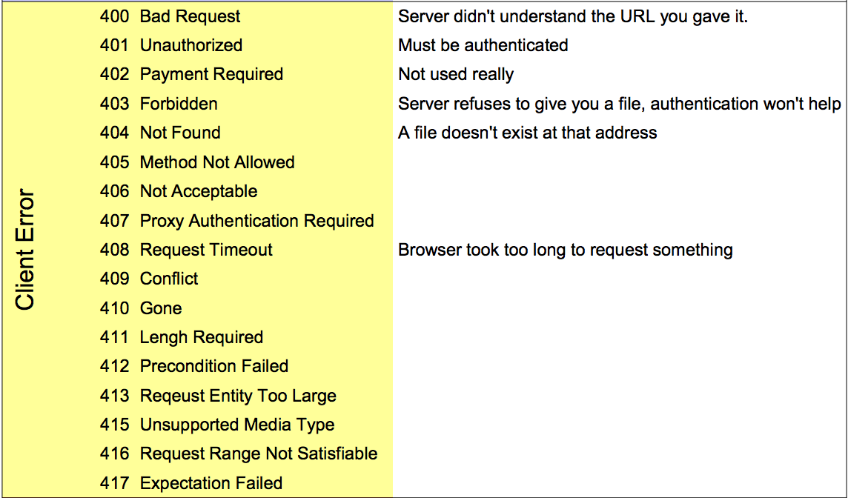
Client Error Codes

Slide 25
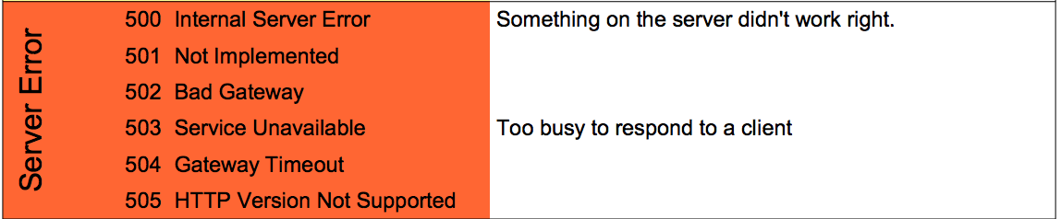
Server Error Codes

Slide 26
Implementing REST

Slide 27

Just do it?!

Slide 28
A good answer if you already know
HTTP coding
JSON
etc

Slide 29
Why use a framework?
Routing
Separate logic for different verbs, paths, content-types
Cacheing and content negotiation
Data format manipulation
Translation to/from JSON
Readability
Security!

Slide 30
Labs approach
Express + tsoa
Built in routing, controllers, structure
Caching, etags
Decorations/annotations
Swagger generation
Security / Authentication

Slide 31
Labs
What exactly does what?
yarn
a package manager for Node (like npm)
Node
Running Javascript on the server
Typescript
Adding type safety to node/js
Express
The web server and core HTTP support
tsoa
Adds @GET, etc, and generates Swagger/OpenAPI (coming in later exercise)
typeorm
Maps typescript objects into databases neatly
nodemon
Checks for changed code and restarts tests/servers
newman
Runs postman tests

Slide 32
Clients?
Typically HTTP clients
OpenAPI/Swagger can help you generate client code automatically
Multiple choices again
Python: httplib2, http.client, requests
Node: http, axios, superagent, etc
Java: JAXRS, Apache HTTPClient, builtin

Slide 33
Summary
Basic REST concepts:
Use the right VERB
Use the right return code
Use well defined media types
Resource representation
Use hyperlinks for HATEOAS

Slide 34
Our sample Purchase service

Slide 35
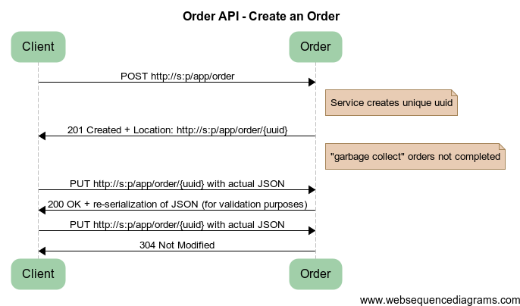
Create an Order
Notes:
title Order API - Create an Order
Client -> Order: POST http://s:p/app/order
note right of Order: Service creates unique uuid
Order -> Client: 201 Created + Location: http://s:p/app/order/{uuid}
note right of Order: "garbage collect" orders not completed
Client -> Order: PUT http://s:p/app/order/{uuid} with actual JSON
Order -> Client: 200 OK + re-serialization of JSON (for validation purposes)
Client -> Order: PUT http://s:p/app/order/{uuid} with actual JSON
Order -> Client: 304 Not Modified

Slide 36
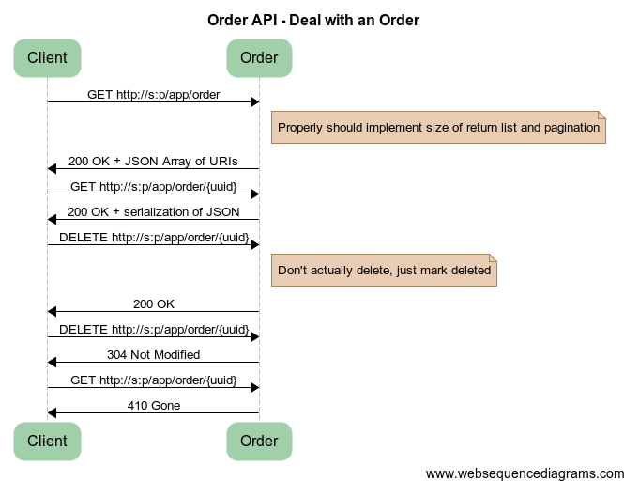
Notes:
title Order API - Deal with an Order
Client -> Order: GET http://s:p/app/order
note right of Order: Properly should implement size of return list and pagination
Order -> Client: 200 OK + JSON Array of URIs
Client -> Order: GET http://s:p/app/order/{uuid}
Order -> Client: 200 OK + serialization of JSON
Client -> Order: DELETE http://s:p/app/order/{uuid}
note right of Order: Don't actually delete, just mark deleted
Order -> Client: 200 OK
Client -> Order: DELETE http://s:p/app/order/{uuid}
Order -> Client: 304 Not Modified
Client -> Order: GET http://s:p/app/order/{uuid}
Order -> Client: 410 Gone

Slide 37
Questions?

